Slide 1
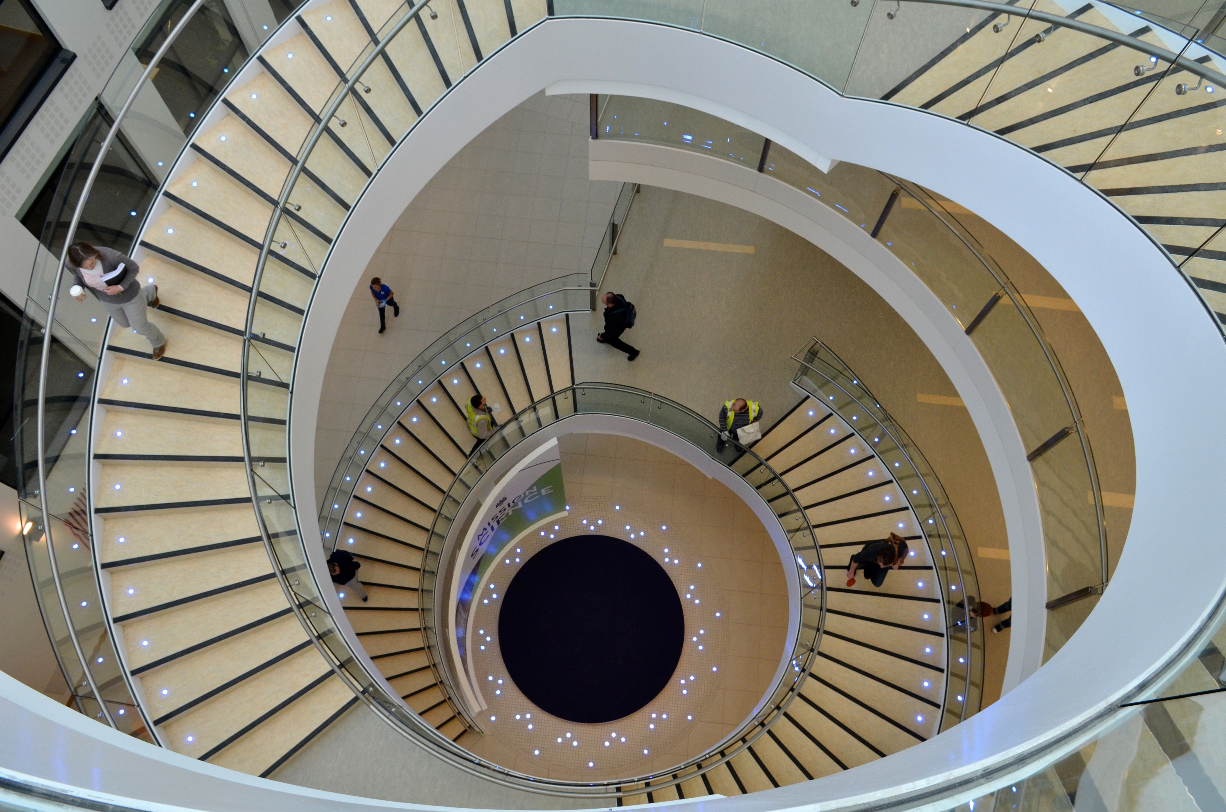

seminars

Slide 2

The Giant Leaps of Mankind
Notes:
So with that, let’s jump right into the algorithm.

Slide 3

The failures of technology

Slide 4
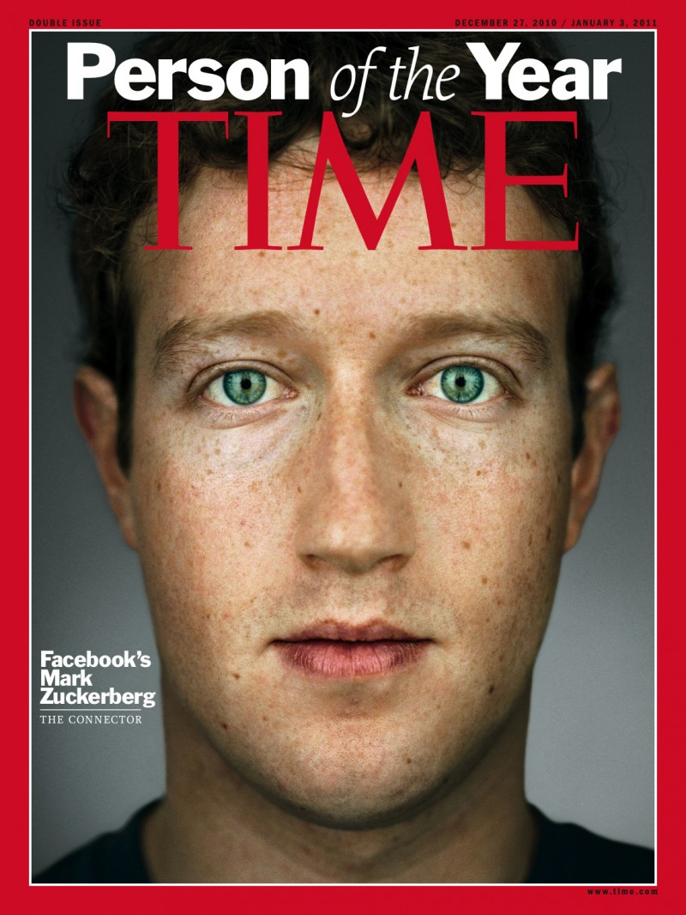
2010

Slide 5
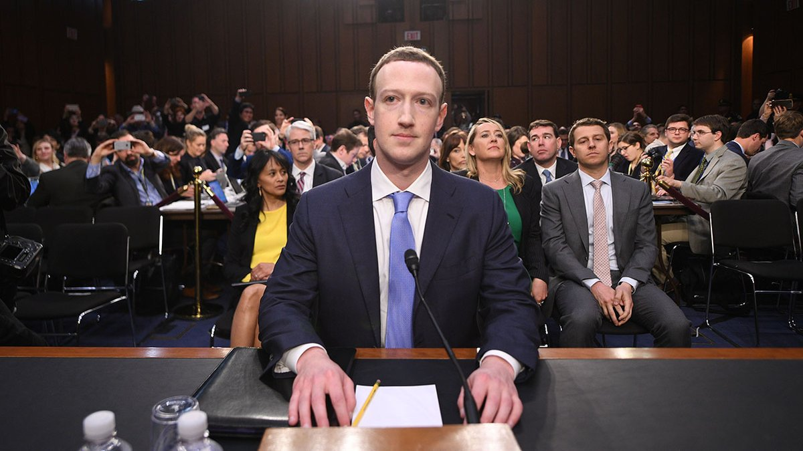
2018

Slide 6
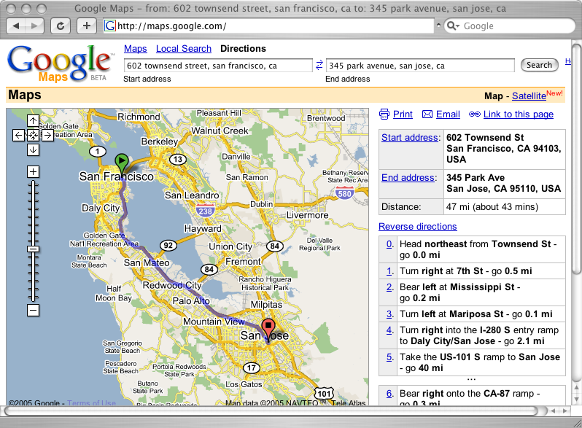
2005

Slide 7
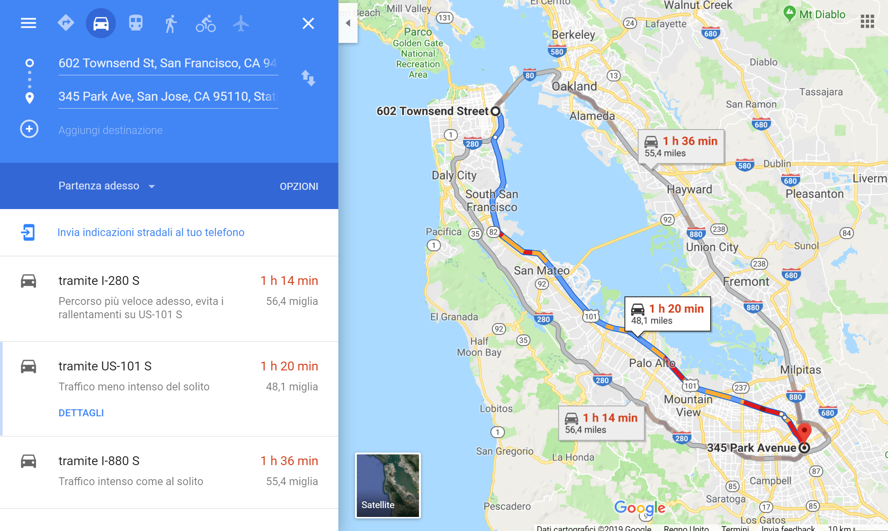
2019

Slide 8
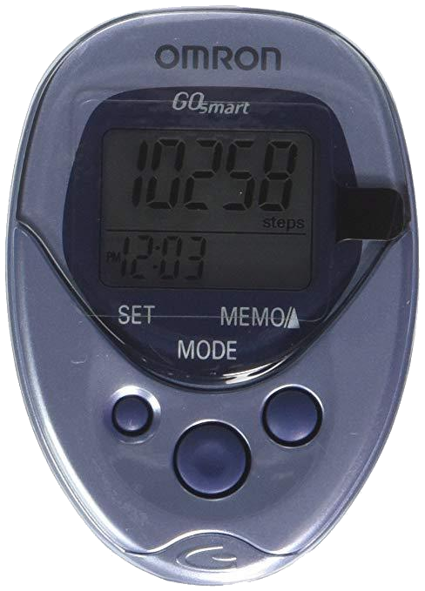
2010

Slide 9
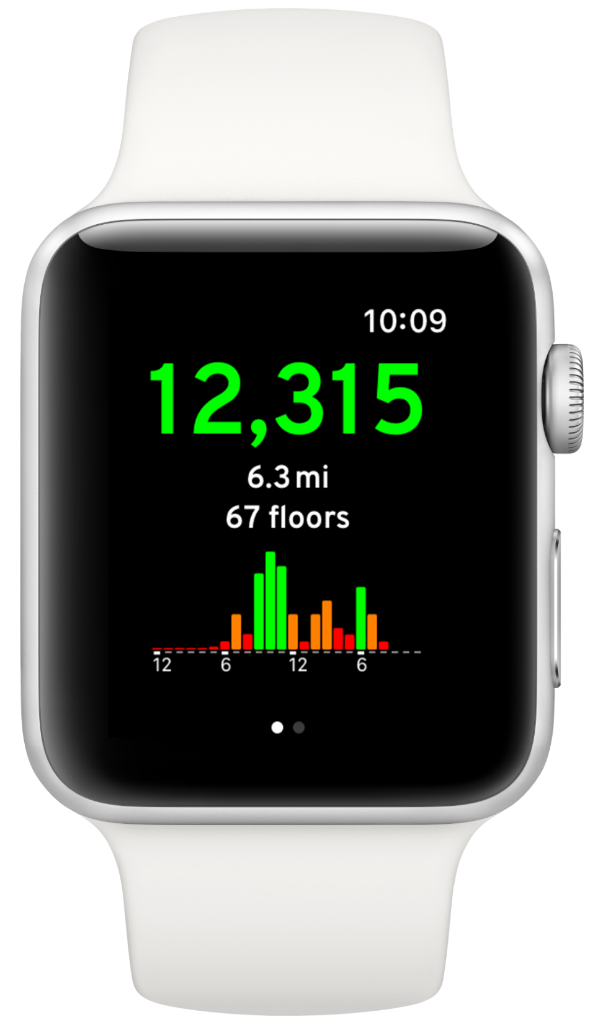
2019

Slide 10

Optimizing for efficiency

Slide 11

Optimizing for engagement

Slide 12
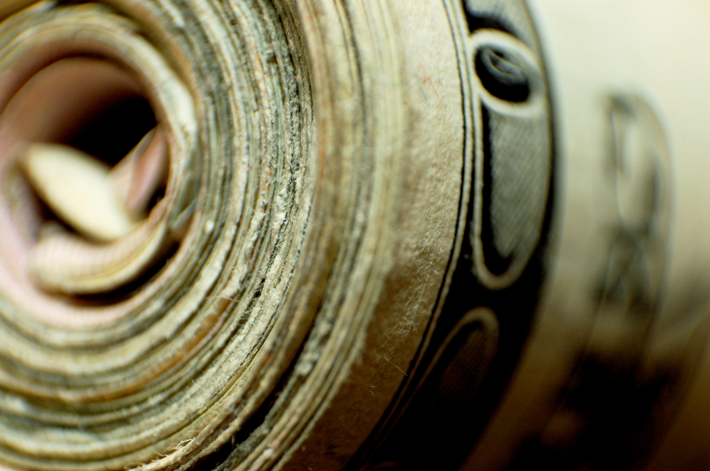
Optimizing for revenue

Slide 13
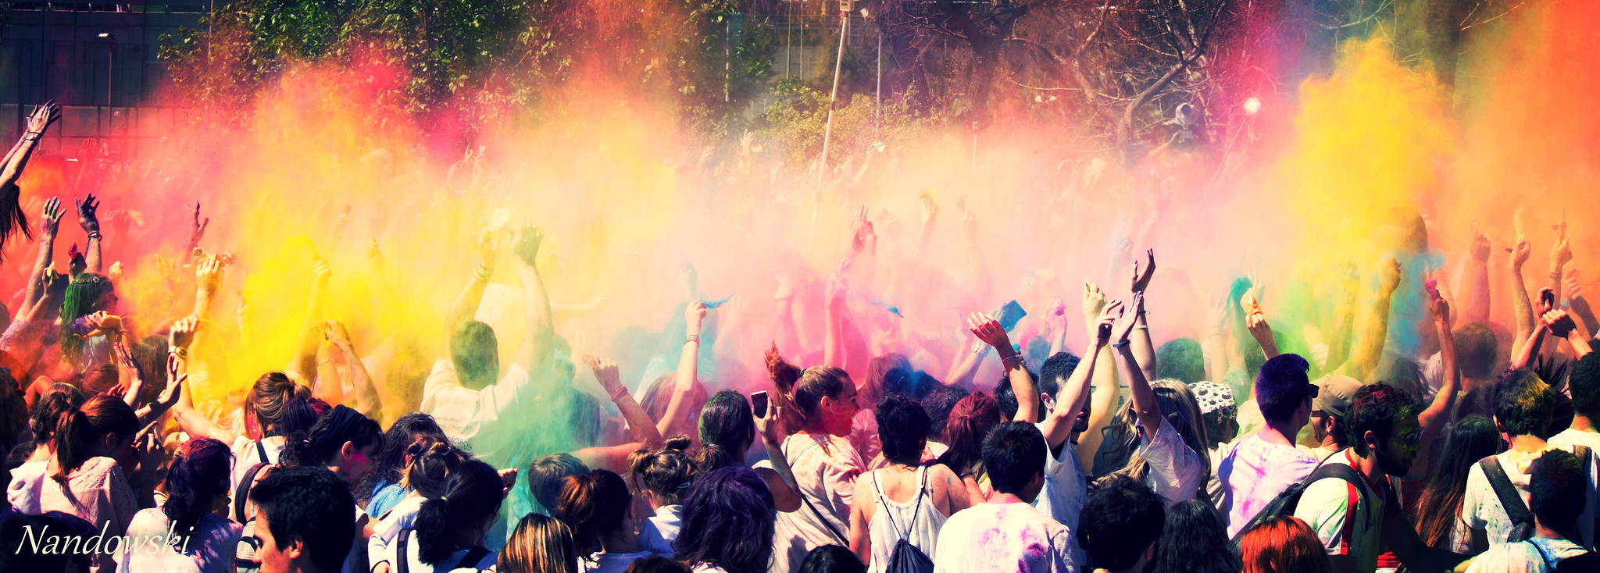
…but what about happiness?

Slide 14


The Intangible Things that Make Us Happy
Luca Maria Aiello

Slide 15



City life
Healthy life
Social life

Slide 16
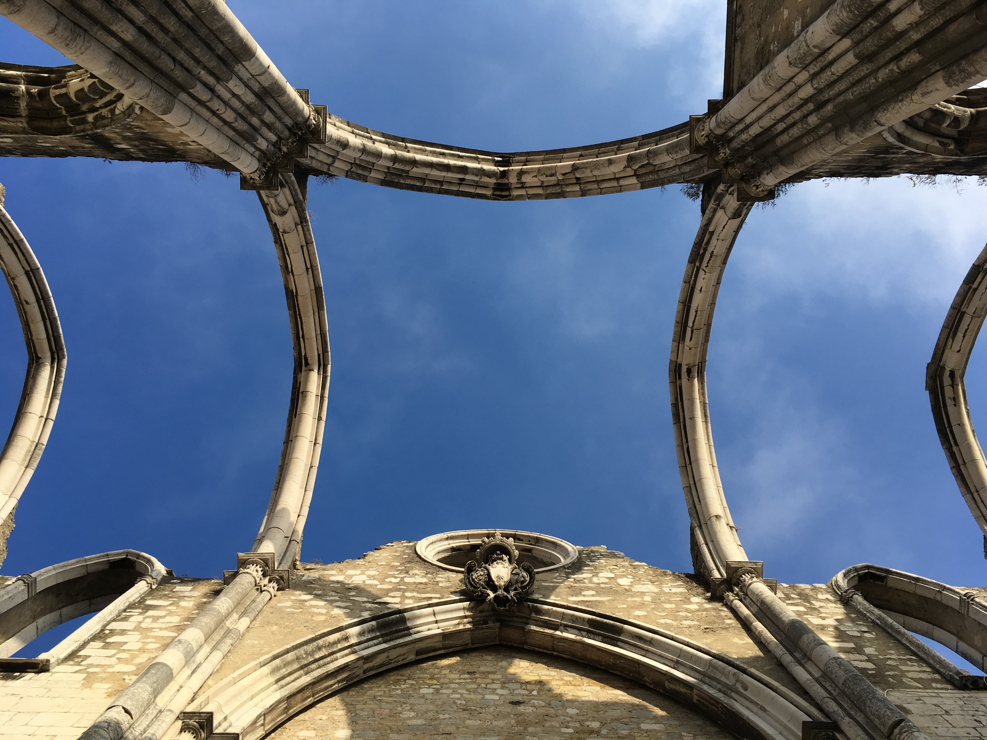
Part I:
The Spirit of the City

Slide 17
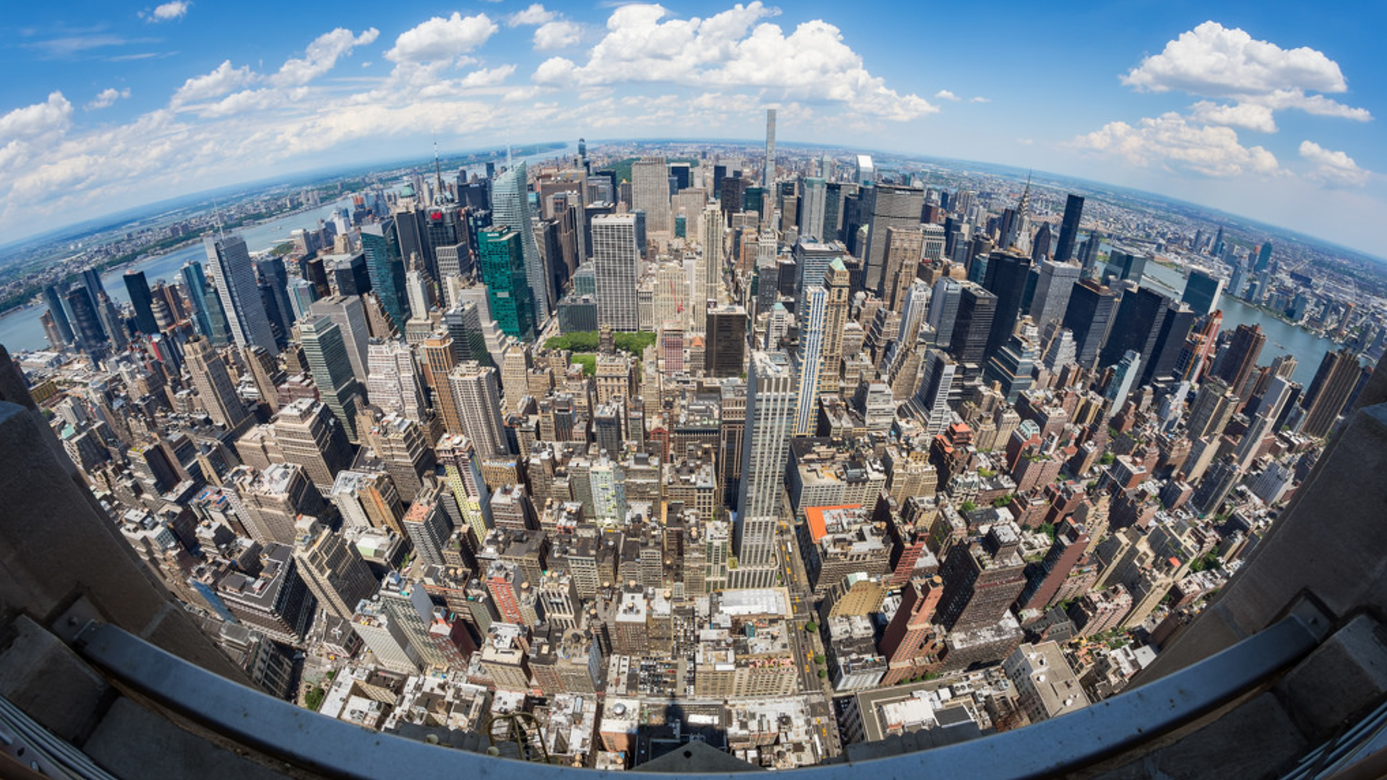
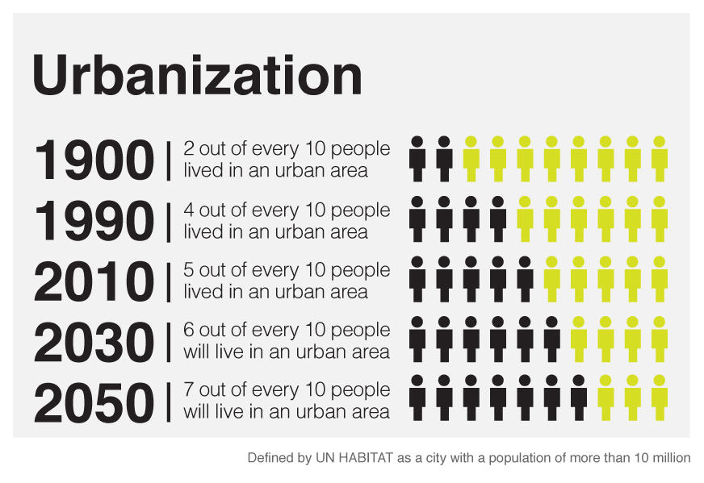
Urbanization
Smart and efficient cities are crucial for sustainability

Slide 18



Smart City = Efficiency

Slide 19

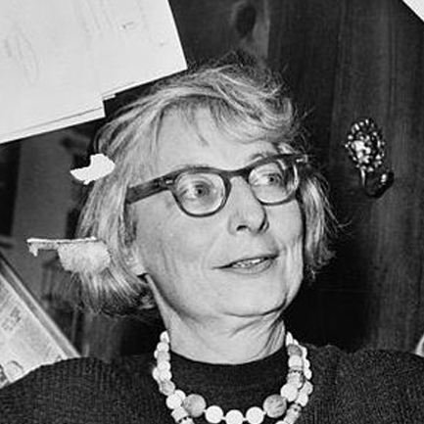
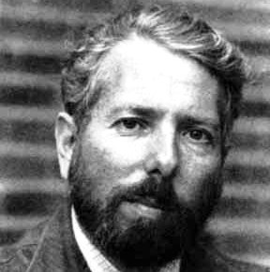
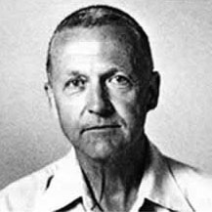
Jane Jacobs
Stanley Milgram
Kevin Lynch
Psychological perceptions

Slide 20
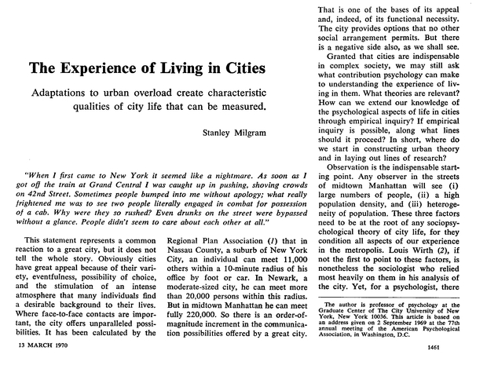
“It may seem that urban atmosphere is too evanescent a quality to be reduced to a set of measurable variables, but I do not believe the matter can be judged before substantial effort has been made in this direction.”
Stanley Milgram

Slide 21
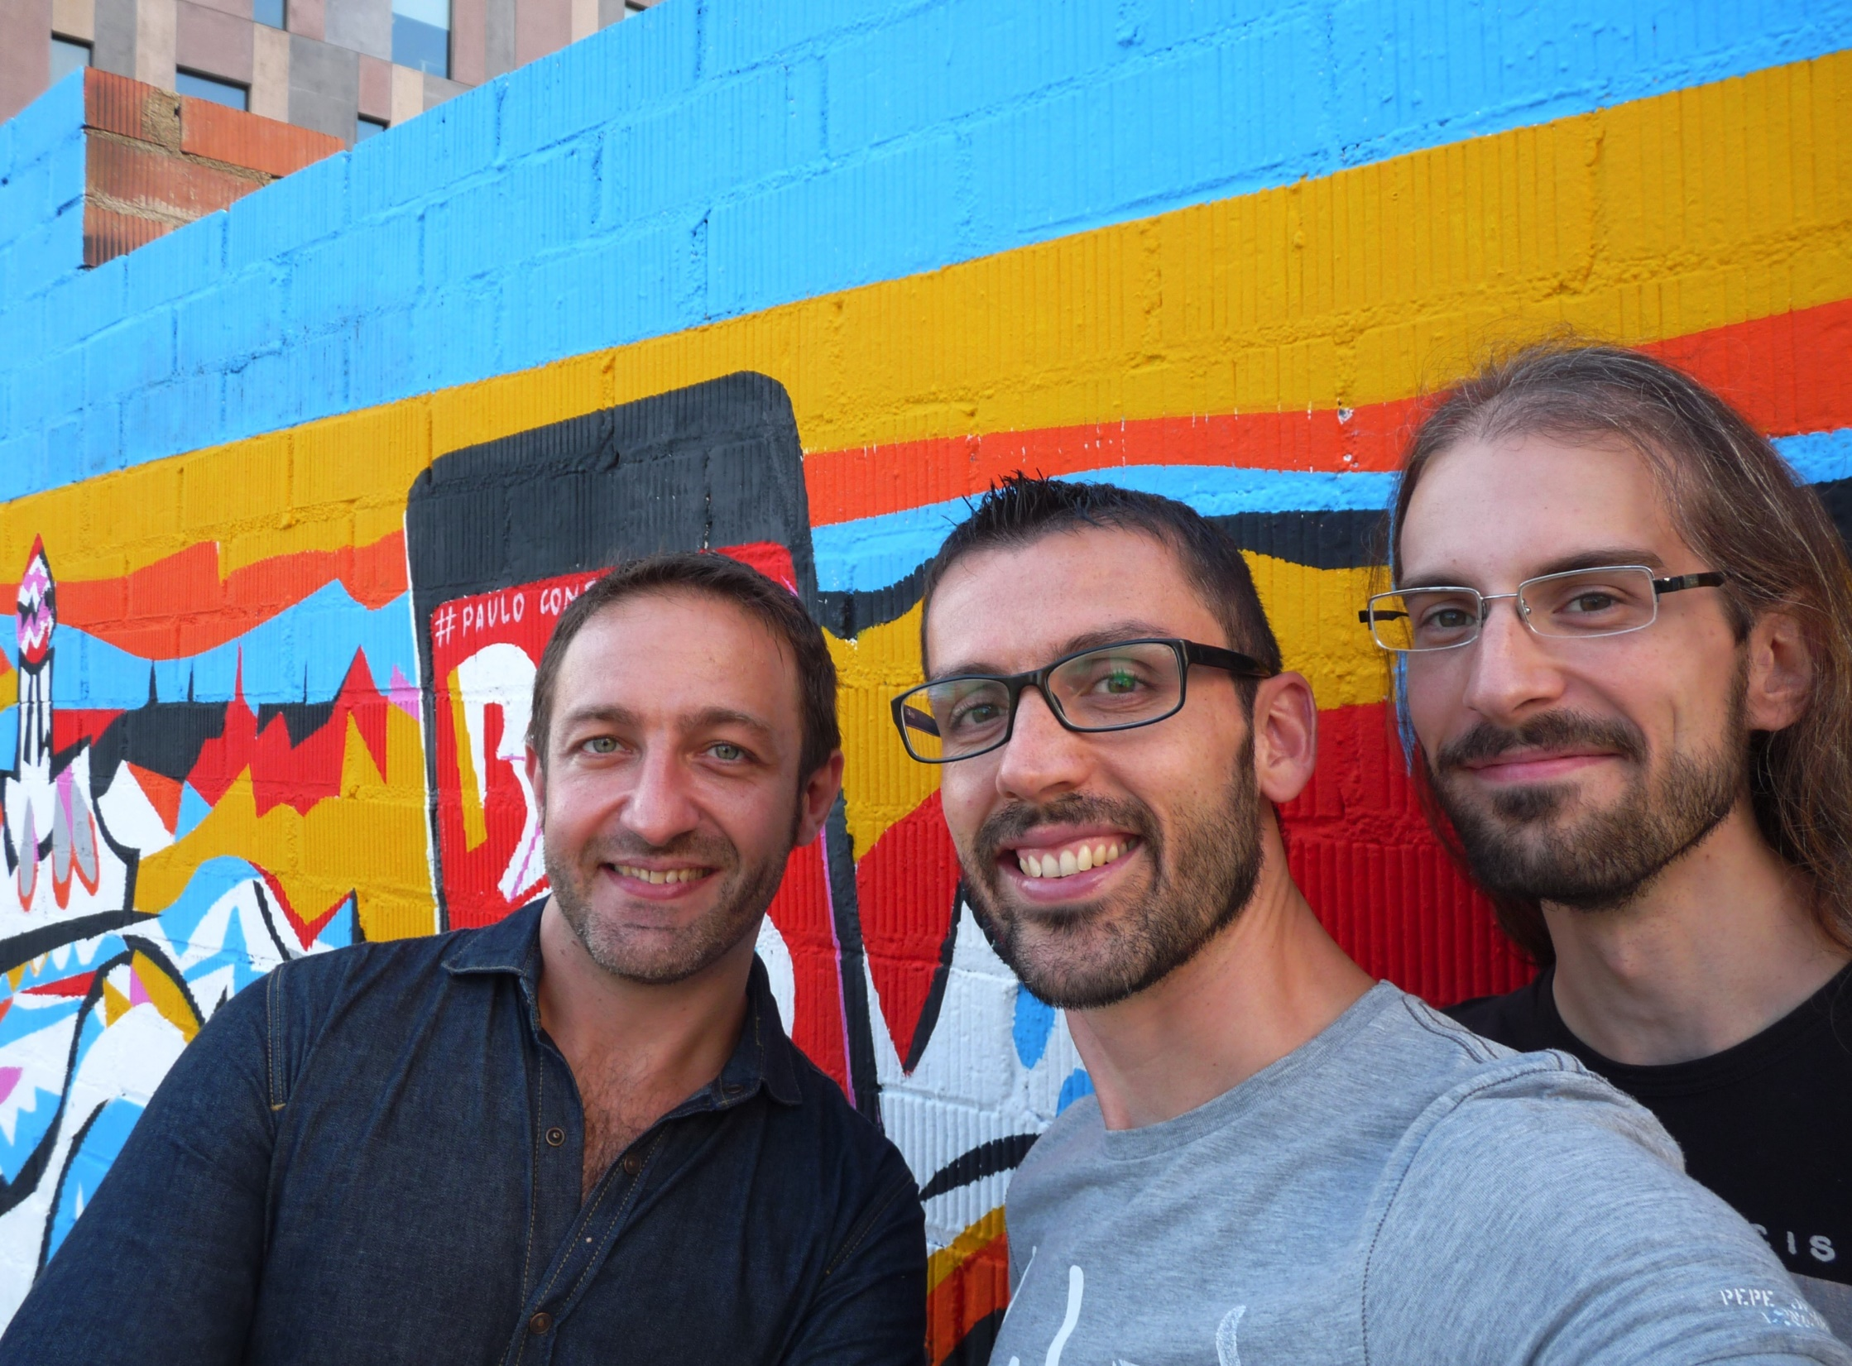

Slide 22
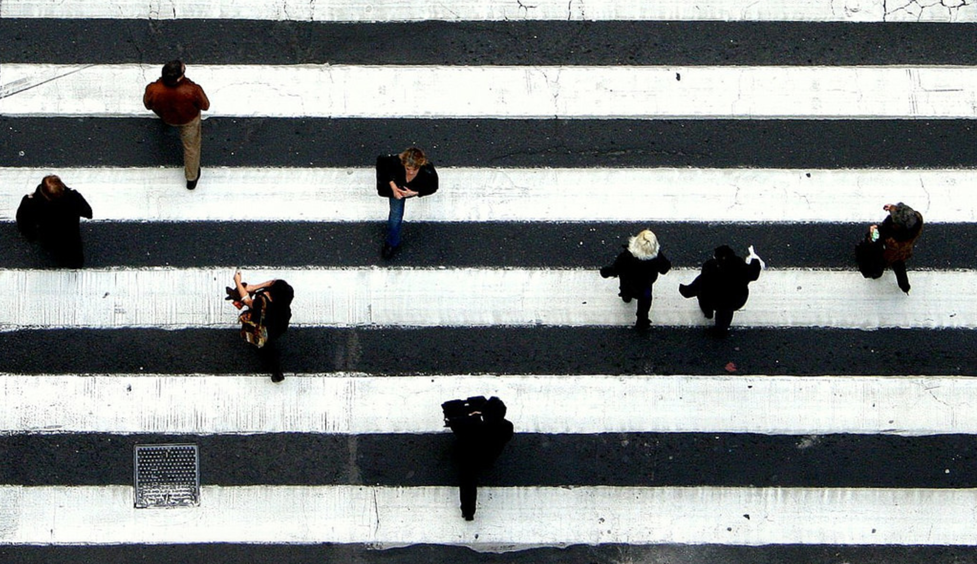
The quest for a
Good City Life
© Sandra Rodriguez on Flickr

Slide 23
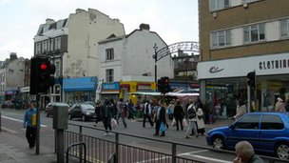
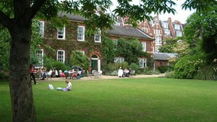
Collective perception of beauty
A
B

Slide 24
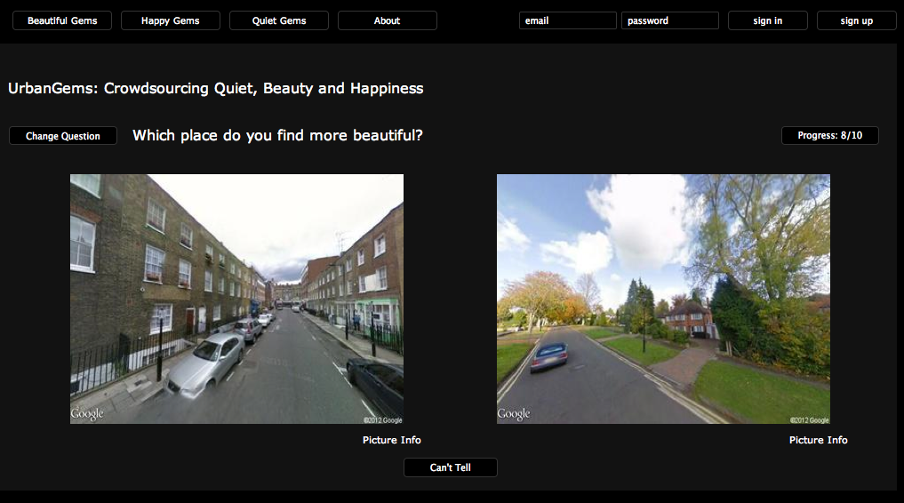
www.urbangems.org

Slide 25
Most
beautiful
…
Least
beautiful

Slide 26
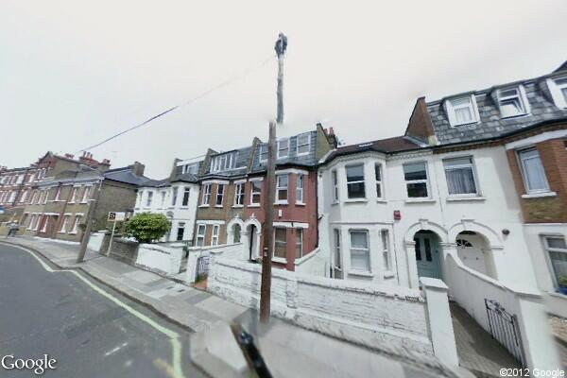
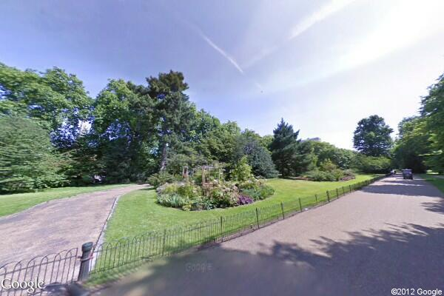
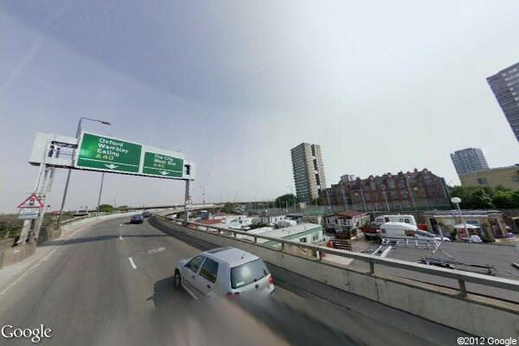
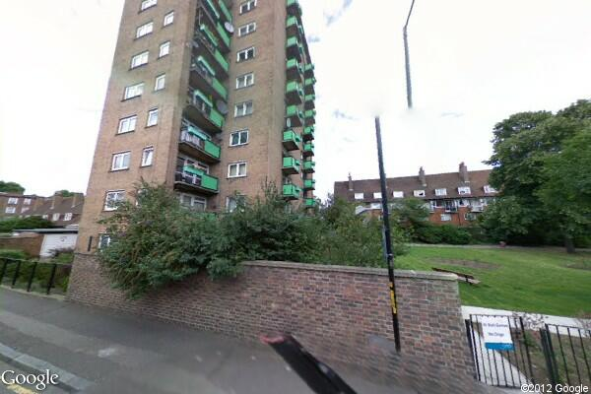
Which urban elements make people (un)happy?

Slide 27
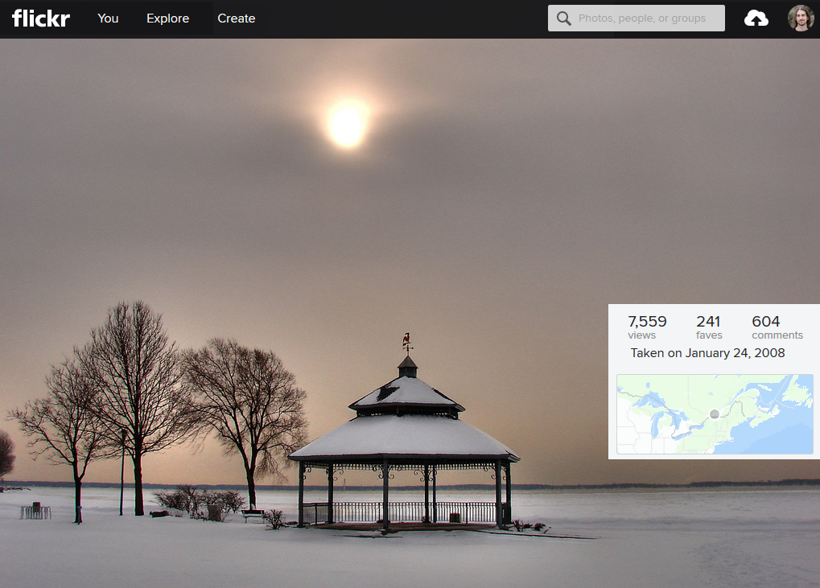
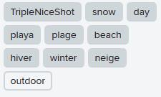
Generalization with social media

Slide 28

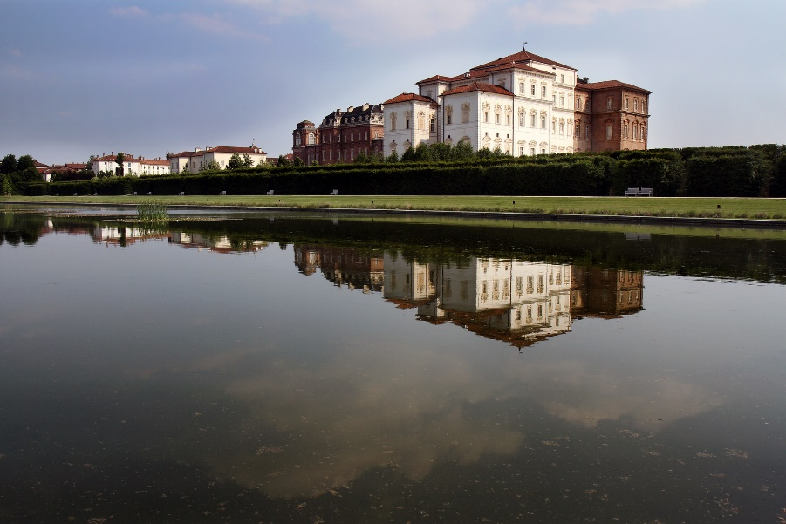
Beauty and the Machine
learn

Slide 29
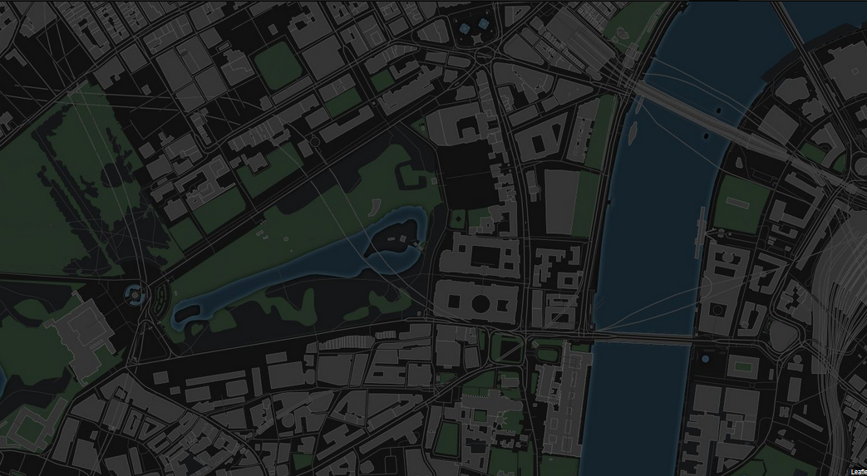


Happy Maps
A
B
“The Shortest Path to Happiness” ACM Hypertext’14

Slide 30
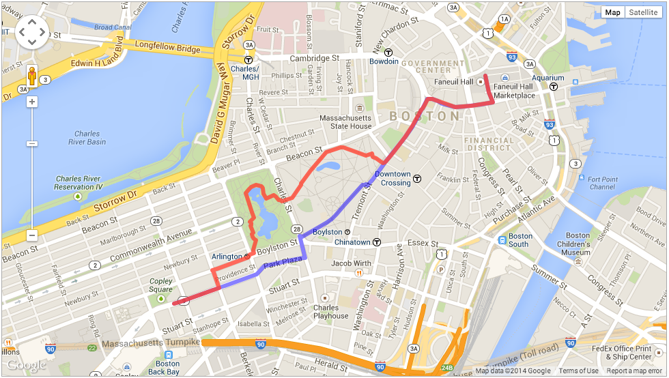
Survey with 54 participants in Boston and London
Recommended paths are, on average, 35% more beautiful than the shortest paths and not much longer

Slide 31
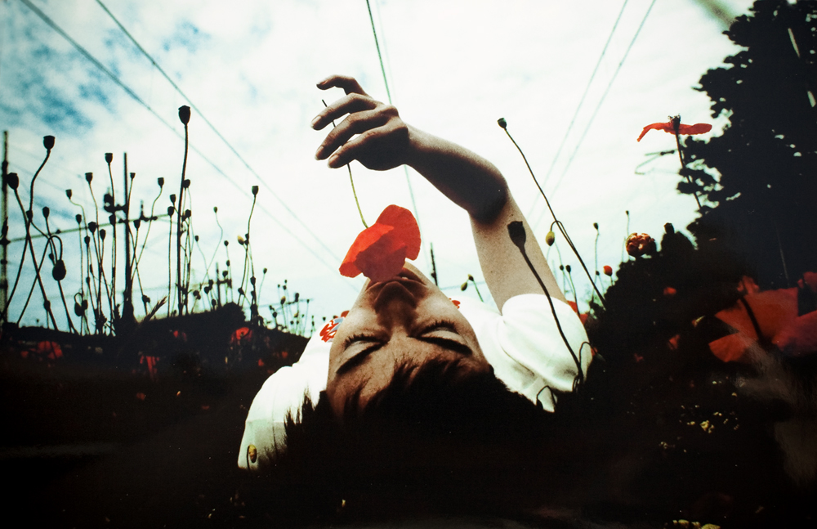
Notes:
https://www.flickr.com/photos/anacoreta/4857292433/sizes/l
https://www.flickr.com/photos/photopaname/15384117742
https://www.flickr.com/photos/leighkemp/14989996890/sizes/l

Slide 32
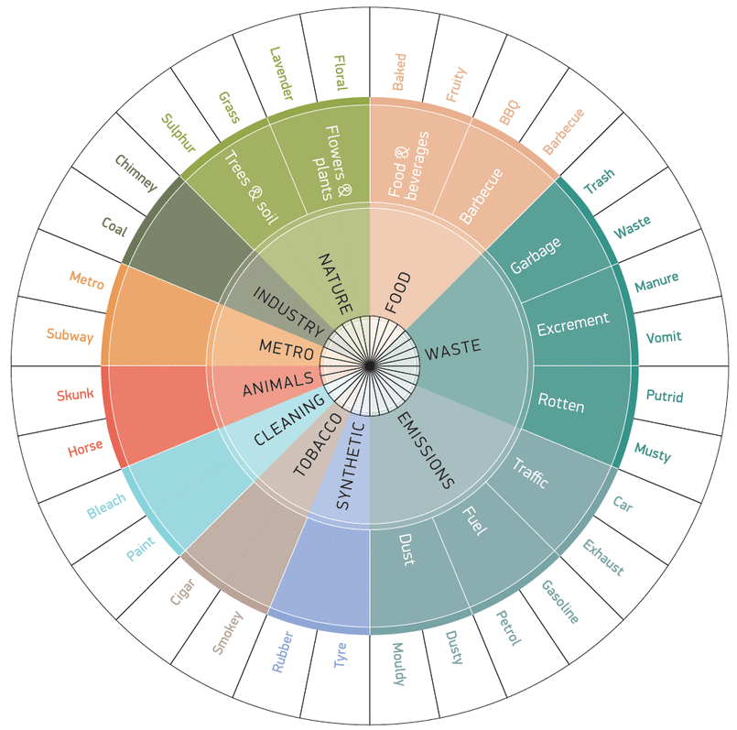


Slide 33
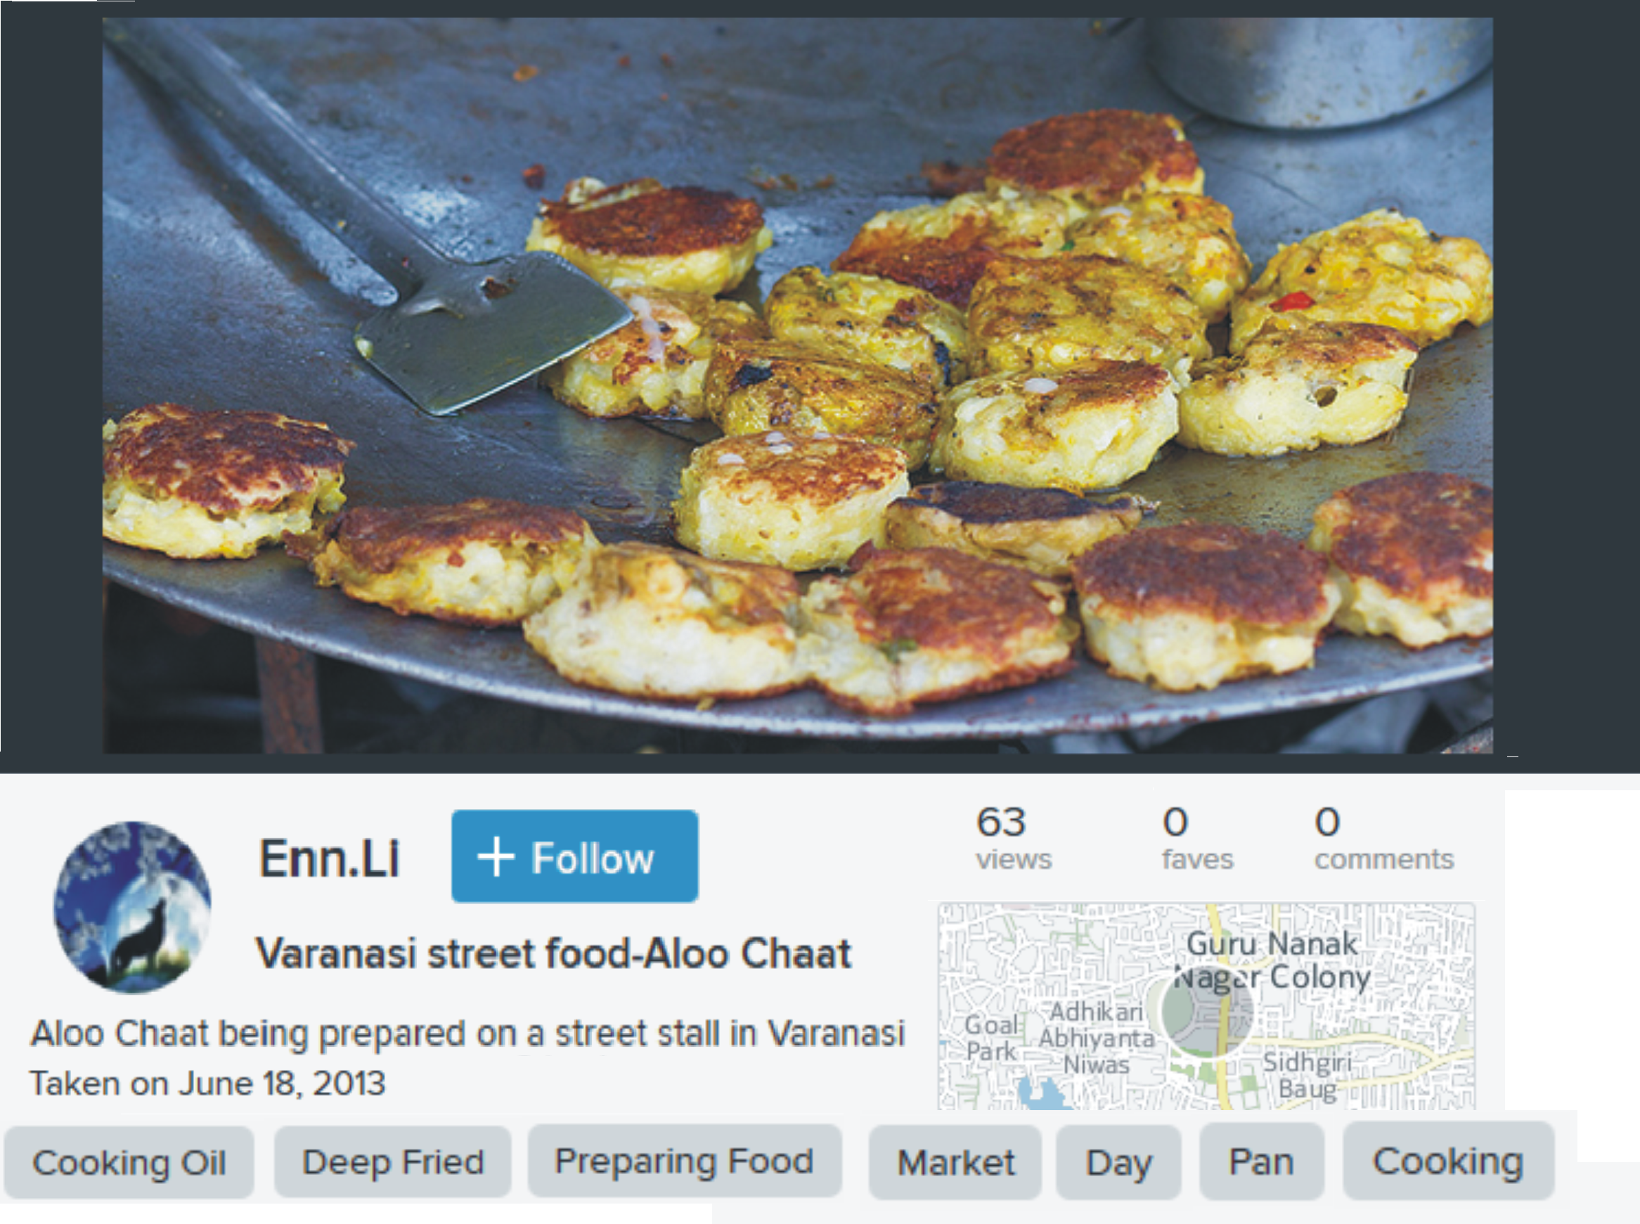
30

Slide 34
50m
Smelly Maps
Sound profile:
60% emissions
30% food
10% waste
“Smelly maps” AAAI ICWSM’15

Slide 35
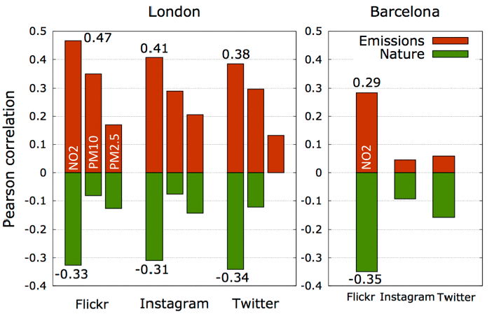
Ecological validity

Slide 36
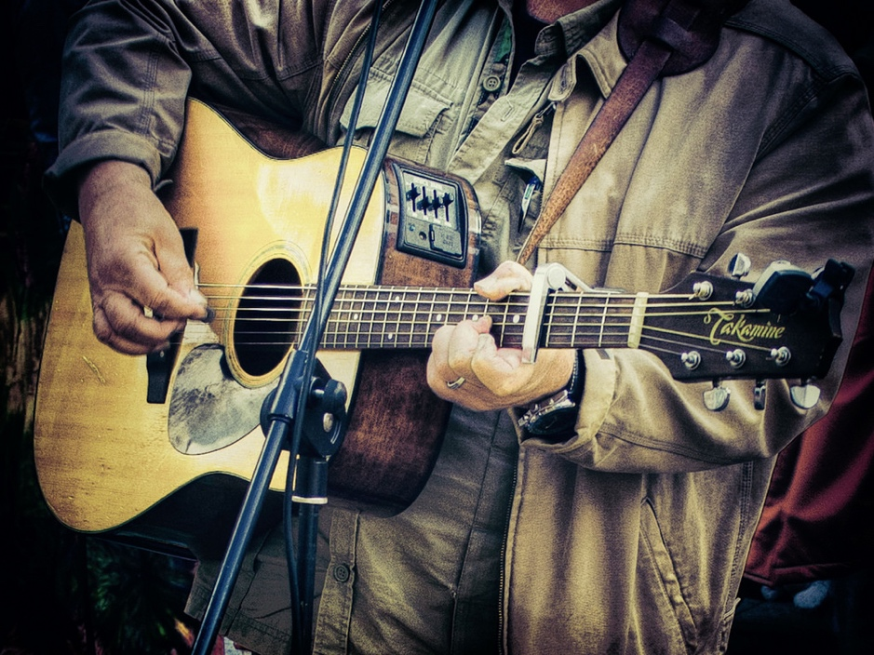

Slide 37
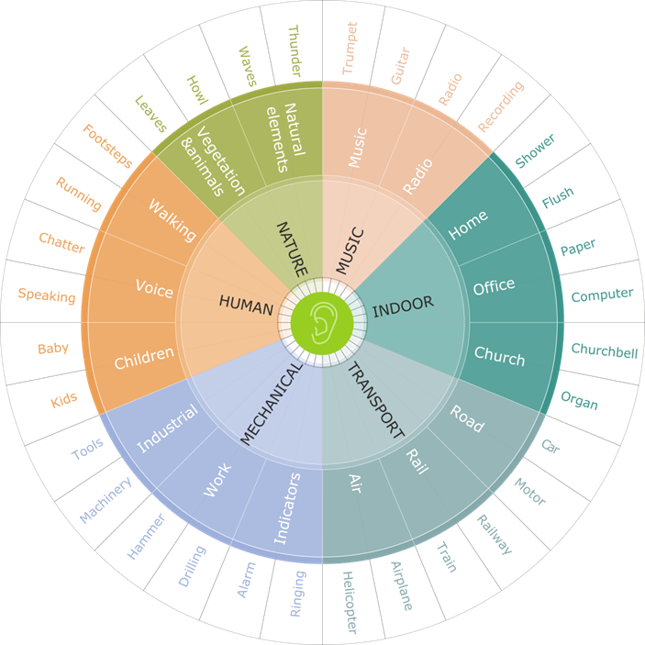


Slide 38
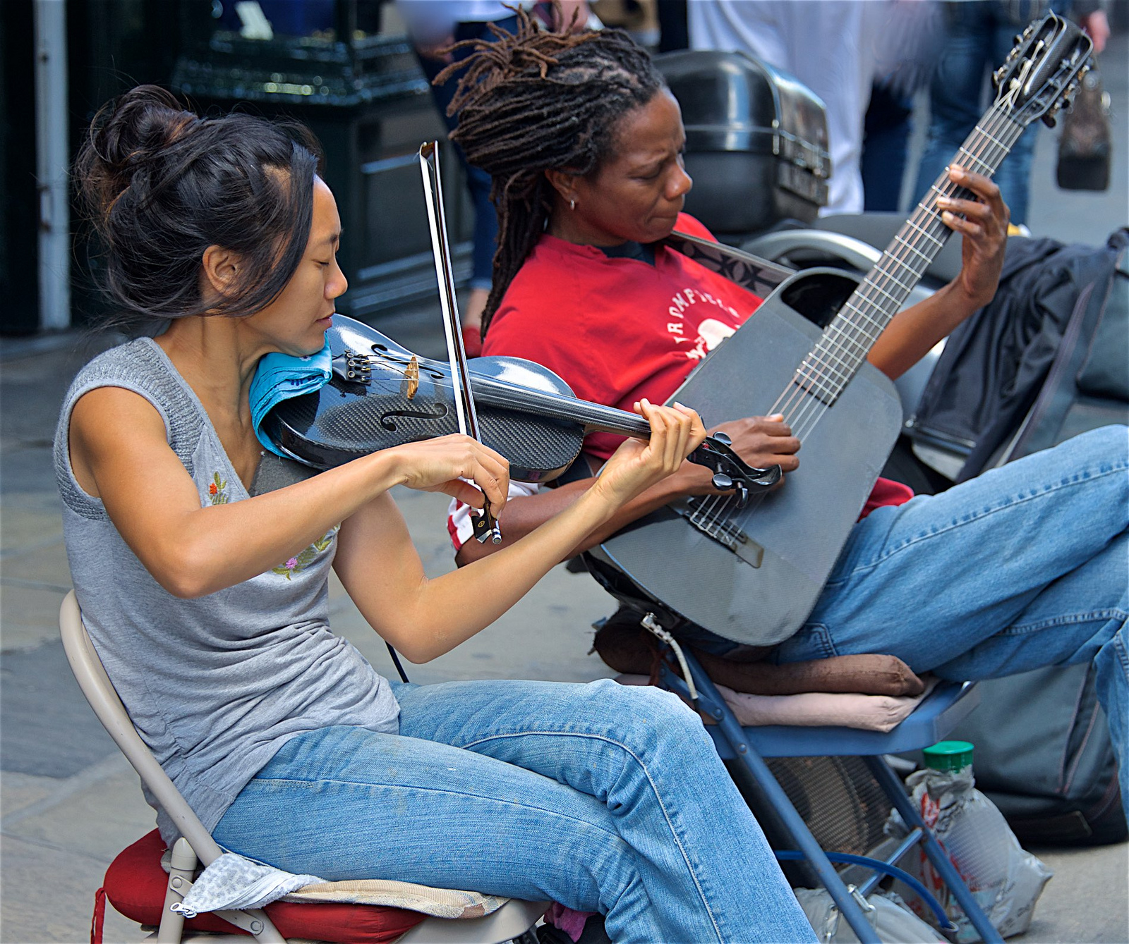
© Scott Johnson on Flickr
Notes:
https://www.flickr.com/photos/sswj40/27296397823

Slide 39
50m
Chatty Maps
Sound profile:
75% transport
20% human
5% music
“Smelly maps” AAAI ICWSM’15

Slide 40

Happy
Smelly
Chatty
Emotion
Walkability
Activity
Ambiance
Culture
Maps

Slide 41
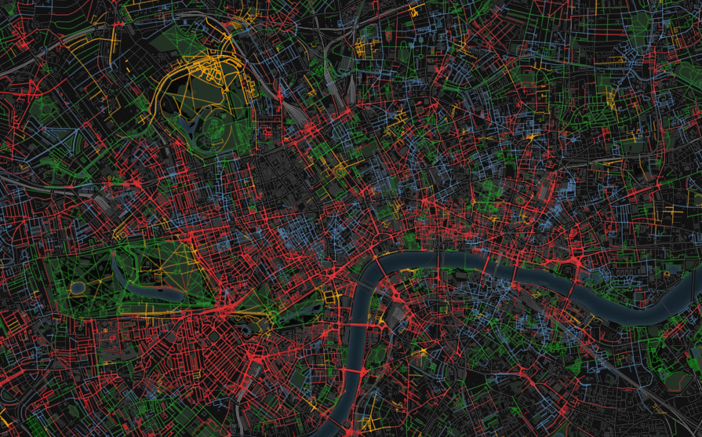
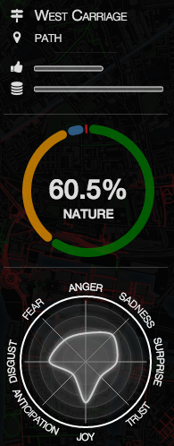
www.goodcitylife.org

Slide 42
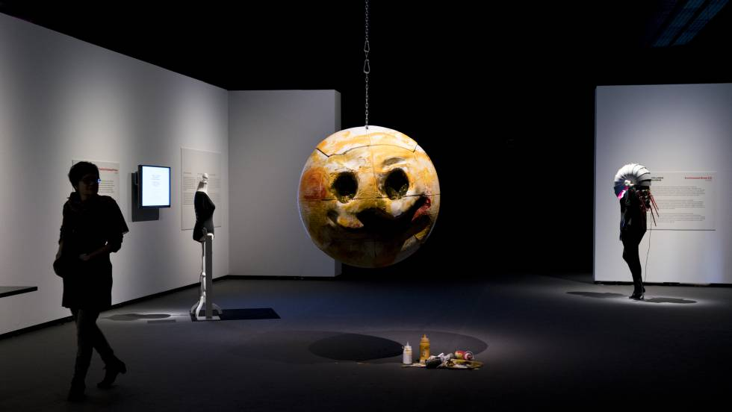
The Ultimate Emoji
At MWC 2019

Slide 43
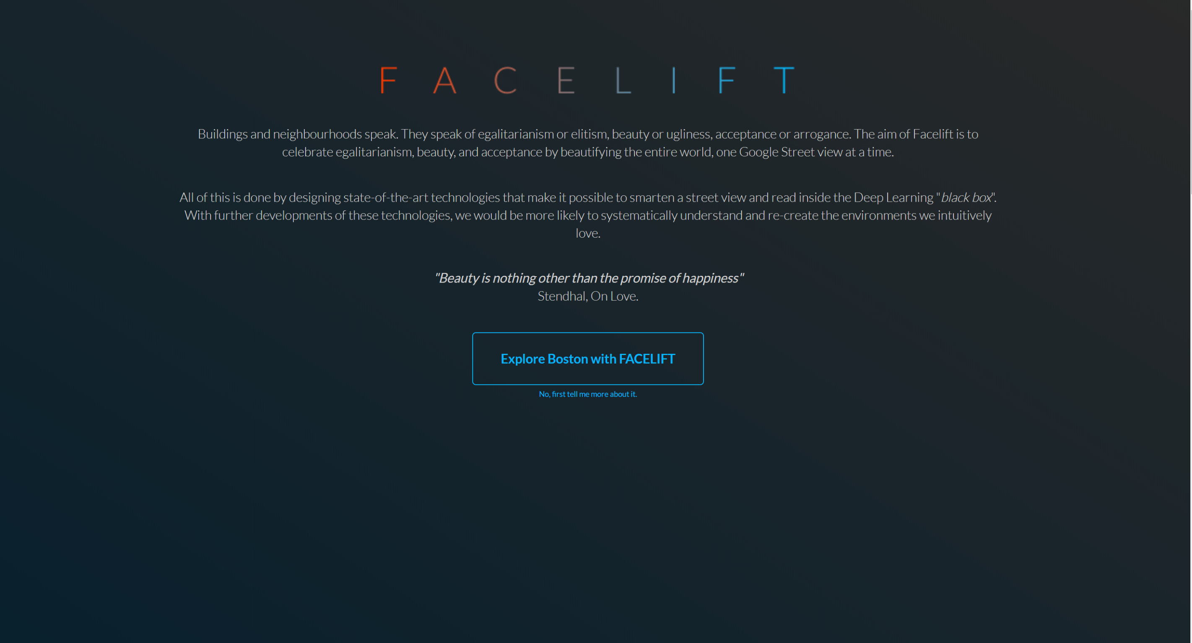

Slide 44
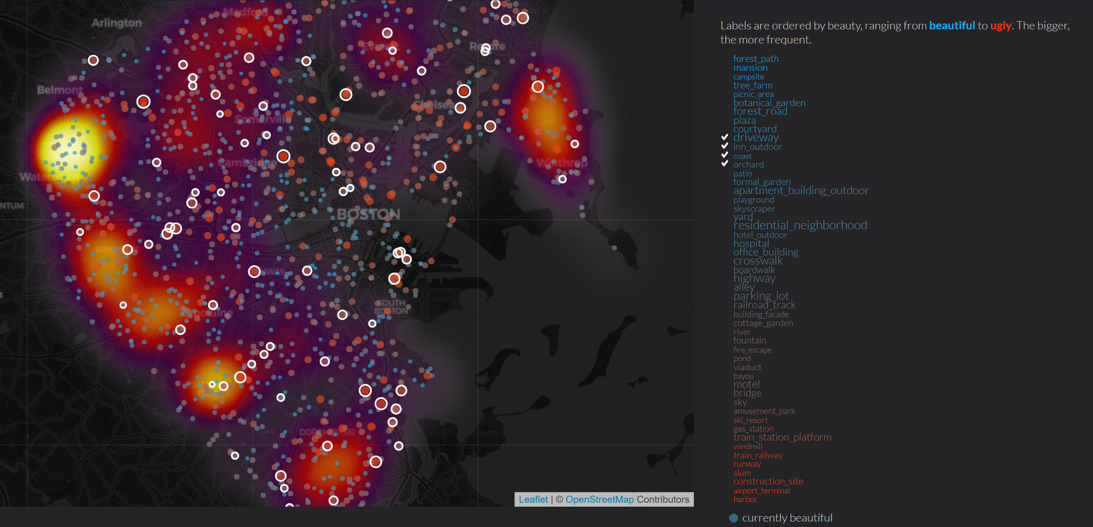

Slide 45
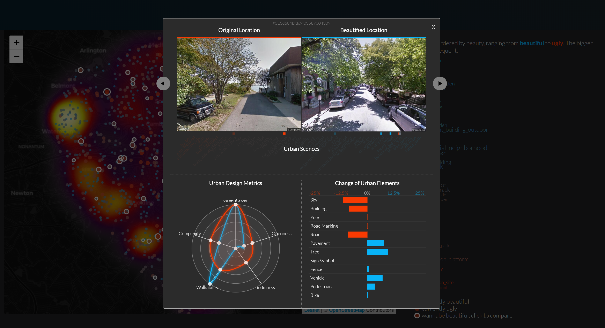

Slide 46
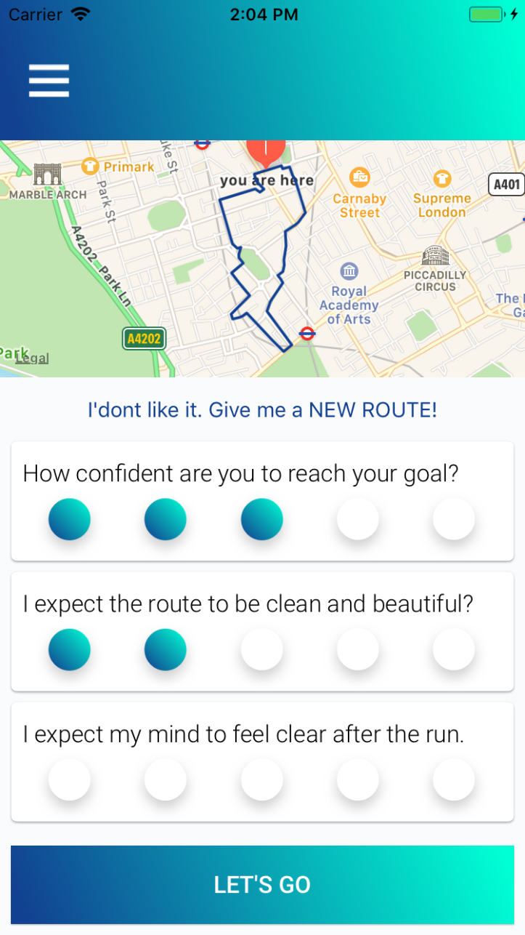
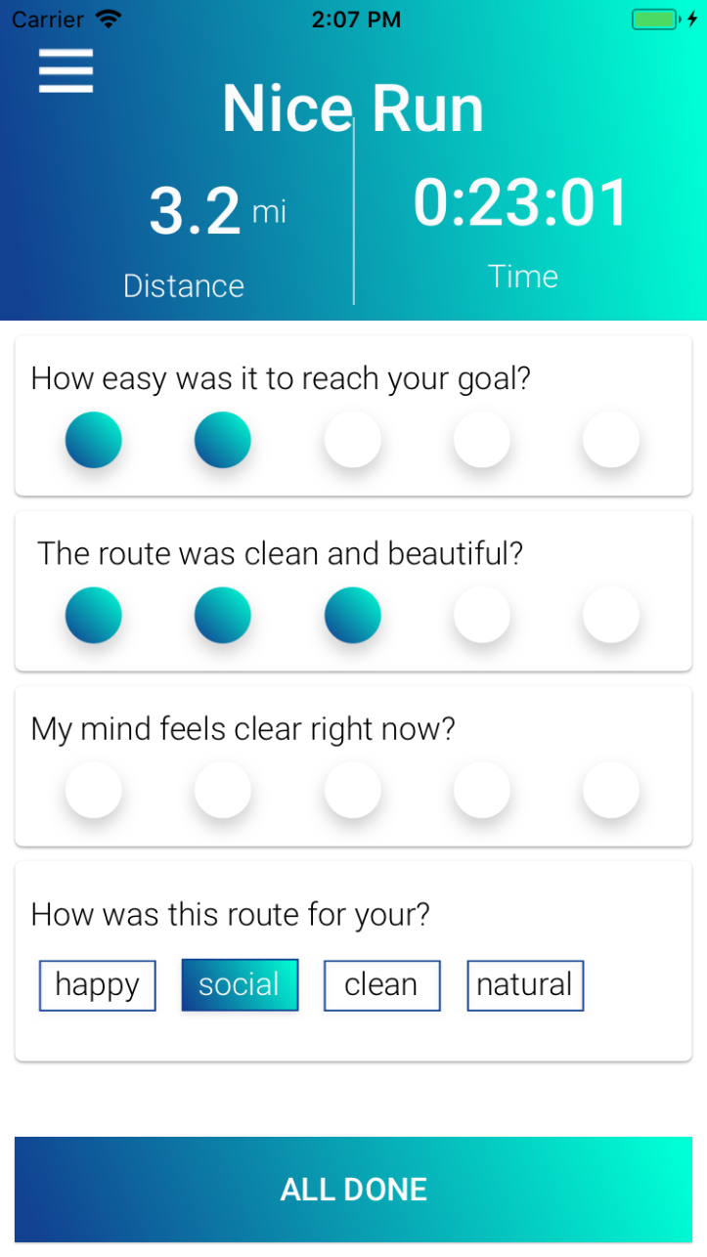
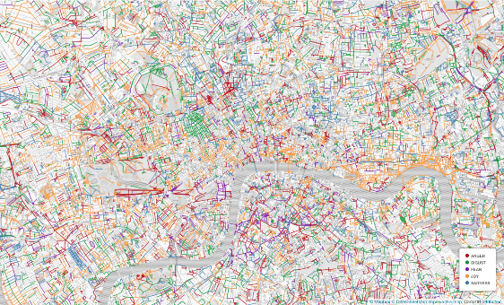
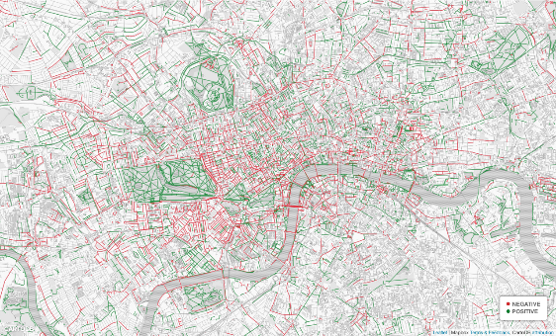
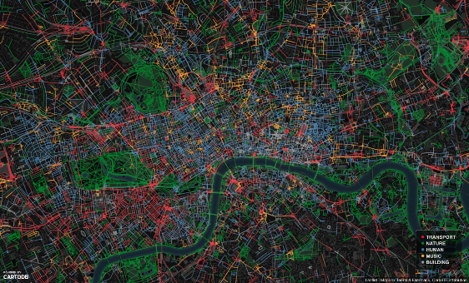
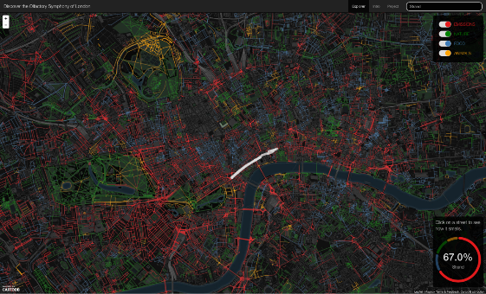
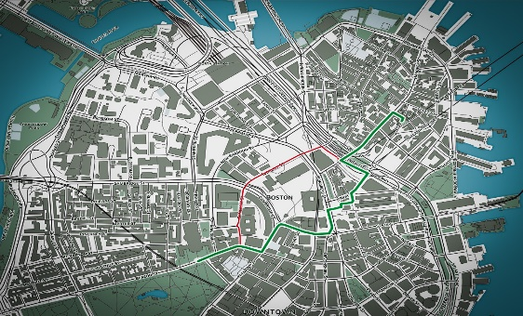
The Ultimate Running App
Soon on iOS
The experience of Running – To appear

Slide 47



















“The shortest path to happiness” TED 2014
The Shortest Path to Happiness – Hypertext’14
Smelly Maps: The Digital Life of Urban Smellscapes – ICWSM’15
The Digital Life of Walkable Streets – WWW’15
The Emotional and Chromatic Layers of Urban Smells – ICWSM’16
Chatty maps: constructing sound maps of urban areas from social media data – RSOS’16
The Spirit of the City: Using Social Media to Capture Neighborhood Ambiance – CSCW’18
Diversity of indoor activities and economic development of neighborhoods – PLOS ONE’18
The New Urban Success: How Culture Pays – Frontiers’18
Mapping and Visualizing Deep-Learning Urban Beautification – IEEE CGA’18
The Experience of Running – to appear

Slide 48

Part II:
The Voice of Your Heart

Slide 49

Stress
Disorder of 21st century
(50% affected in USA)
Impact on biorhythms
External events
© stephanr66

Slide 50


“There is, of course, no way to quantify the scope of mental anguish caused by Trump’s campaign; these stories are entirely anecdotal.” – Survey Aug 2017

Slide 51


Measuring biorhythm changes
Nokia health dataset
11,600 users in London and San Francisco (age: 42, : 44%)
~4M daily data reports over 365 days
Steps, sleep duration, sleep time, heart rate (90% days)

Slide 52



Number of sleep hours
2016
2017

Slide 53


Average heart rate
2016
2017

Slide 54

Volume

Slide 55

Periodicity

Slide 56

Synchronicity

Slide 57



Event profiling

Slide 58


Heart rate variation on music exposure
Positive
Negative
Neutral
P
HRV
Your Biorhythm on Music: Using Smartwatches to Infer Music Emotions – to appear

Slide 59

Lifestyle diseases
80% deaths in Western World
300k premature deaths in EU by obesity
€70B spent in EU yearly

Slide 60

No large-scale data

Slide 61


Food purchase data
Tesco, the largest food retailer in UK (30% of the market)
411 stores in greater London
1.6B products purchased by 1.6M customers in 2015 (zip code)
77k unique products
Nutritional info and ingredients

Slide 62

Penetration
LSOA
MSOA
Ward
Borough

Slide 63







The “average” food product
MSOA

Slide 64

Dataset coming soon:
“Large-scale and high-resolution analysis of food purchases and health outcomes”

Slide 65

Nutrients consumption vs. WHO guidelines

Slide 66


Consumption in space
Fat
(departure from recommended levels)
Sugar
(departure from recommended levels)

Slide 67


Consumption in space
Fibers
Nutrient diversity

Slide 68

Prescription data
NHS dataset on GP medicine prescriptions
1,174 practices in Greater London
1.1B prescriptions in 2016

Slide 69



Hypertension
Diabetes
Cholesterol

Slide 70


Matching food and prescriptions
MSOA

Slide 71

Food consumption vs. diseases

Slide 72

Food consumption vs. diseases

Slide 73

Food consumption vs. diseases

Slide 74







Food consumption vs. diabetes

Slide 75

Diabetes: Diversity+ Energy
R² = 0.59

Slide 76

goodcitylife.org/food

Slide 77

Part III:
The Science of Social Interactions

Slide 78

…
Understanding social communication
True
Nature
Pragmatics
Semantics
Sentiment & Emotions
Polarity
Strength
Structure
The Nature of Social Structures – Springer Encyclopedia

Slide 79

Definition
Operationalization
Computational social science

Slide 80
Operationalizing tie strength
…
True
Nature
Pragmatics
Semantics
Sentiment & Emotions
Polarity
Strength
Structure

Slide 81

Operationalizing tie strength
Granovetter’s theory
Strength from social conversations
Strength of a tie is a combination of amount of time, emotional intensity, intimacy, and reciprocal services which characterize a tie
Predicting Tie Strength with Social Media – ICWSM

Slide 82
Operationalizing pragmatics
…
True
Nature
Pragmatics
Semantics
Sentiment & Emotions
Polarity
Strength
Structure

Slide 83

Communicative acts

Slide 84





Resource exchange
Blau’s Social exchange theory
Reading the Source Code of Social Ties – WebSci

Slide 85

Resource exchange
Social support
Status-giving
Knowledge exchange

Slide 86

Assortativity
Knowledge net
Status net

Slide 87

What are the types of social interactions that people experience?

Slide 88

Literature review

Slide 89
Similarity
shared interests, hobbies, motivations, outlooks on life
2. Trust
high degree of dependability, and reliability
3. Romance
physical, emotional, and sexual attraction
4. Social support
high degree of emotional warmth, closeness
5. Identity
forms of meaningful common group memberships
6. Status
admiration, respect, prestige
7. Knowledge transfer
exchange of ideas, learning, and mentorship
8. Power
having the "upper hand," more resources, imbalance
Literature review
Psychology
Social Psychology
Sociology
Economics
Biology

Slide 90

Crowdsourcing

Slide 91
Word-collection on MTurk
“Write the words the [best describe | matter most to you]
in a social relationship”
362 Unique words, 151 non-redundant
200 workers. 45% women, 81% White from Canada, UK, US
Coloring in the Links: Capturing Social Ties as They are Perceived – CSCW

Slide 92

Word-scoring on MTurk
Each word is represented by a 200-dimensional vector of scores (1 entry per worker)
Coloring in the Links: Capturing Social Ties as They are Perceived – CSCW

Slide 93

Word clustering
Negative
Iteratively cluster these
Positive
Blockmodeling on correlation matrix
Coloring in the Links: Capturing Social Ties as They are Perceived – CSCW

Slide 94

Word clustering
Coloring in the Links: Capturing Social Ties as They are Perceived – CSCW

Slide 95


Link prediction
B
B
Can we do better than this?
A
A
Simple word matching
2
1
0
Coloring in the Links: Capturing Social Ties as They are Perceived – CSCW

Slide 96


Ability to spot lies
Perception of
Social ties
Well-being and
self-representation

Slide 97


Slide 98



Slide 99


Slide 100
Summary

Slide 101
Efficiency
vs.
Perceptions
Activity
vs.
Feeling
Engagement
vs.
Value

Slide 102
Human-centric design
Interdisciplinarity

Slide 103








































Jérémie
Rappaz
Sebastian
Deri
Tobias
Kauer
Eva
Sharma
Miriam
Redi
Kate
McLean
Francesco
Aletta
Krisztián
Varga
Bogdan
State
Rossano
Schifanella
Daniele
Quercia
Przemek
Grabowic
Sagar
Joglekar
Alexander
Robertson
Collaborators
Eva
Roitmann
Katrin
Hansel
Albert
Barque-Duran
David
Martin-Borregon
Desi
Hristova
Lucia
Del Prete

Slide 104



Thank you!
@lajello
www.lajello.com
lajello@gmail.com

Slide 105


Bell Labs

